Slide 1
Internet & World Wide Web

Slide 2
Internet
It is the interconnection of computer networks all over the world so that users can share and exchange information and communicate with each other.
It is worldwide collection of networks that connects millions of businesses, government agencies, educational institutions and individuals.
Internet is a network made up of hundred of thousand of computers all over the world, with millions of users connected electronically by communication lines (telephone lines, fiber-optic cables and other links).
Internet is a huge network of computers all connected together.

Slide 3
A computer network is a connection of two or more computers for the purpose of communicating and sharing information and other resources.
A computer network is a set of computers connected together for the purpose of sharing resources.
Computers on a network can be connected through cables, telephone lines, radio waves, satellites, or infrared light beams or through wireless communication.
The aim of connecting these computers is to enable sharing of resources such as printers, documents, computer programs, hard disk etc.
Common resource shared today is connection to the Internet.

Slide 4
Types of Computer Network
Local Area Network (LAN)
An interconnection of computers and other devices in a limited geographical area.
Wide Area Network (WAN)
Covers a large geographical area to provide national and international communication.

Slide 5
Local Area Network (LAN)
LAN connects computers and other devices in a limited geographical area such as a home, school, office building, or closely positioned group of buildings
LAN is an interconnection of computers and other devices at a single geographical site.
LAN is a private network that offer reliable high speed communications for interconnecting equipment in a limited geographical area.
Do not require external network services e.g. telephone network or leased data lines.
LANs used by companies are called enterprise networks.
LAN are widespread as a result of:
Increasing need to transfer data between computers within the organisation.

Slide 6
Purpose of LAN
LANs allow:
Data transfer between computers
Access to data stored somewhere
Messages to be passed between computers
Shared use of peripherals e.g. printers
Shared use of computing resources

Slide 7
Wide Area Network (WAN)
Covers a large geographical area to provide national and international communication.
A network that connects computers in different locations either regional, national or International.
Connections require the use of Telecommunication equipment such Telephone lines, radio waves, satellites or wireless communication.
WANs can be accessed through dial-up using a modem (dongle e.g. MTL, TNM, Airtel) or leased-line direct connection used by large organisation.
A good example of WAN is the Internet.

Slide 8
What is needed to connect to the Internet ?
Hardware
I.e Computer, Modem, Dongle, Telephone line, Wireless infrastructure, cables, hub, switch, routers etc.
Internet Service Providers (ISP)
ISP refers to a company that provides Internet services, for personal and business access to the Internet.
i.e MTL, Airtel, TNM, Globe Internet, Skyband etc..
Software
Web Client Software (Browsers) e.g. Internet Explorer, Mozilla Firefox, Google Chrome.

Slide 9
What can you do with the Internet ?
Find information by using search engines
File Transfer (download & upload files)
Send and receive messages by electronic mail (email)
School (eLearning)
Electronic Trading (eCommerce)
Companies and their customers making use of networks as a means of advertising, buying and selling goods and services
Teleworking or Telecommuting
Making use of networking technology to allow working at different location while keeping in touch with co-workers
Tele and video conferencing
Groups of people conducting meetings via a telephone or video network.
Publish information on your own web site
Make airline reservations
Get directions and draw maps
International debates or discussion groups

Slide 10
In order to communicate across the Internet, a computer must have a unique address.
Every computer on the Internet has a unique numeric identifier, called an Internet Protocol (IP) address.
An IP address, is a number that uniquely identifies each computer or device connected to the Internet.
IP address usually consists of four groups of numbers, each separated by a period.
The number in each group is between 0 and 255. For example, the numbers 72.14.207.99 and 192.168.10.33 are IP addresses.

Slide 11
In addition to an IP address, most Internet hosts or servers have a Domain Name System (DNS) address which uses words.
A domain name is a unique name that identifies an internet resource such as a website
A domain name is the text version of an IP address.
Numeric IP addresses are difficult to remember and use.
Thus, Internet supports the use of a text name that represents one or more IP addresses.
A domain name identifies the type of institution that owns the computer.
An Internet server owned by IBM might have the domain name ibm.com.
An Internet server owned by Mzuzu University have the domain name mzuni.ac.mw.

Slide 12
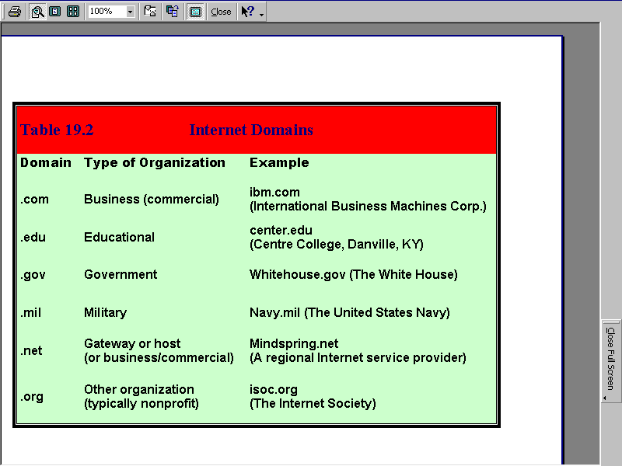

Slide 13
World Wide Web (www, web)
World Wide Web is a system of connected documents on the Internet that can be searched for information about a particular subject.
World Wide Web is a collection of electronic documents that are linked together like a spider web.
Web is a collection of webpages found on the network of computers.
Web is part or service of the Internet that uses text, images, sound, and video.
These electronic documents are stored on computers called servers located around the world.

Slide 14
Web Page
A web page is an electronic document or resource of information that can be accessed through a web browser.
A web page is a page of information on the Internet about a particular subject that forms (a part) a website
A web page is an electronic document on the world wide web.
A web page is an electronic document written in a computer language called HTML (Hypertext Markup Language).

Slide 15
Web page
Web pages are stored on web servers located around the globe.
Web server is a computer system or program that finds and send web pages in response to requests from Internet users.
A web page can contain text, graphics, video, animation, links to other pages, links to other files, and sound, as well as interactive features, such as data entry forms.

Slide 16
Hyperlink
Hyperlink is a connection that allow users to move between two web pages on the Internet
A web page contains links to other web pages as well.
These links are called hyperlinks and
Hyperlinks could be words, pictures or any graphics
Hyperlinks connects users to other pages of related information.

Slide 17
Hyperlink
Allows quick navigation through a website or to a new website.
Mouse pointer will turn into a hand shape when moved over a link.
With hyperlinks one can move through a vast amount of information by jumping from one web page to another.
Navigation through pages of information is called surfing or browsing.

Slide 18
Web Site
A website is a set of pages of information on the Internet about a particular subject.
A website is one or more web pages that relate to a common theme, such as a person, business, organization or a subject, such as sports.
A website is a set of web pages consisting of text, audio and video.
A web site is similar to a magazine with articles. It is a collection of web pages.
A web page is an individual page that can be found on a web site.
Most websites have a home page as their starting point, which functions as a table of contents for the site.

Slide 19
Web Browser
Web browser is a software application used to locate, retrieve and display content on the World Wide Web, including Web pages, images and video.
A web browser is a computer program that makes it possible for users to read information on the Internet.
A web browser is the software that users need in order to find, retrieve, view, and send information over the Internet.
User enters web address (URL) into the web browser’s address bar.
The browser communicates with the server to get the information requested by the user.
Examples of Web Browsers are: Mozilla Firefox, Google Chrome, Apple Safari, Opera, Internet Explorer etc.

Slide 20
How the Web Works
4. Server sends requested files to browser to be interpreted
5. User receives file displayed by the browser
Browser
3. Server accepts
and processes
request from
browser
1. 1.User sends request
2. Browser interprets user’s
selection and makes request from appropriate server

Slide 21
Web Server
Web Server is a computer that provides world wide web services on the Internet.
Web servers are computers that deliver (serves up) Web pages.
A Web server is a system that delivers content or services to end users over the Internet.
A Web server consists of a physical server (hardware), server operating system (OS) and software used to facilitate HTTP communication.
A Web server is also known as an Internet server.

Slide 22
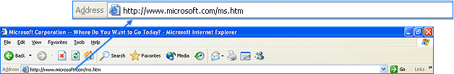
Uniform Resource Locator (URL)
URL is the address of an Internet page on a Web site. E.g. http://www.mzuni.ac.mw
URL is the address that defines the route to a file on the Web.
URL indicates where a web page is located on the internet.
URL is a location identifier associated with a particular webpage or file on the Internet.
URL is typed into web browser’s address bar to access web pages.

Slide 23
URL contains protocol prefix, domain name, subdirectory name and file name. E.g.
http://www.mzuni.ac.mw/downloads/student_handbook.pdf
URL specifies Internet address of a file stored on a host computer connected to the Internet.
Every file on the Internet, has a unique URL.
Web browsers use URL to retrieve a file from a web server in which it resides.
This file is then displayed on the monitor connected to the user's local machine.

Slide 24
URL format
Each part of the URL directs the browser to the correct web page.
http://library.sullivan.edu/datainfo.html
Hypertext Transfer Protocol (HTTP)
Network Domain (domain name)
Filename (path)

Slide 25
Protocols
A set of rules that enable two devices to connect and transmit data to one another.
A computer language allowing computers that are connected to each other to communicate
Protocols determine how data is transmitted between computing devices and over networks.
TCP /IP
i)Transmission Control Protocol.
This is the standard protocol computers utilize to communicate with one another over a network.
ii) Internet Protocol
This a protocol that enable computers to identify each other over the Internet

Slide 26
Protocols
HTTP – Hypertext Transfer Protocol
HTTP is the set of rules for transferring files (text, graphic images, sound, video, and other multimedia files) on the World Wide Web.
A protocol for informing web browsers how to display information found on a particular webpage.
The main protocol used by the World Wide Web to define how messages are formatted and transmitted.
All Web Pages on World Wide Web use HTTP, making them accessible to all other Web computers.
FTP – File Transfer Protocol.
This is a protocol computers use to send files to one another.
You may either upload or download files using FTP
Upload – To forward a file to a server for later access over the Internet.
Download – To copy a file from an Internet server to recordable media, such as a hard drive, CD, DVD or flash disk.

Slide 27
Protocols involved in sending and receiving emails:
Post Office Protocol 3 (POP3)
Internet Message Access Protocol (IMAP)
Simple Mail Transfer Protocol (SMTP)

Slide 28
Web Browsers: Microsoft Internet Explorer
Microsoft Internet Explorer is the one example of web browser.
It comes with windows operating system.
When you start Internet Explorer, Internet Explorer’s main browser window opens automatically
To display a web page you want, you need to know the website address of the web page you want to view

Slide 29
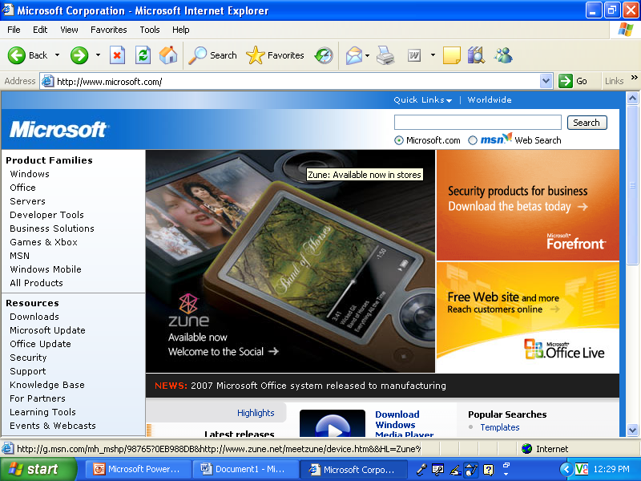
Microsoft Page

Slide 30
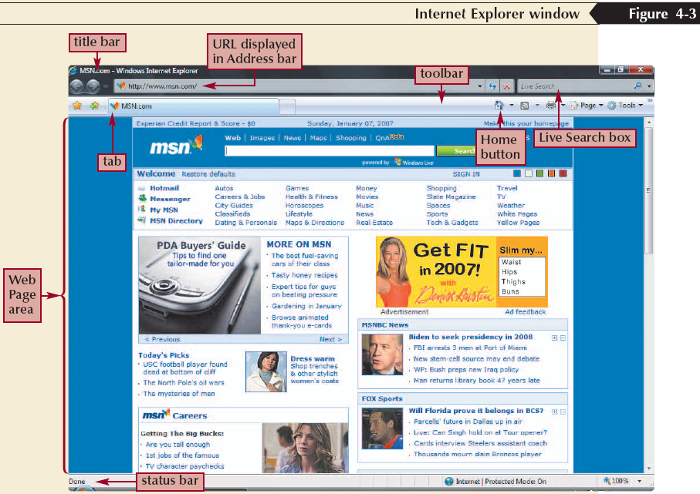
Getting Started with Microsoft Internet Explorer
Click the Start button on the taskbar, and then click Internet Explorer

Slide 31
How to Access Web Pages
Three ways to access Web pages:
Type the Uniform Resource Locator (URL) in the address box.
Click on hyperlinks on a web page.
Use a search tool such as search engine or web directory.

Slide 32
How to Access Web Pages: Type the URL in the Address Box
Type the Uniform Resource Locator (web address) in the browser address box.
Click GO (or press ENTER key on the keyboard).
The URL must be correct (no misspellings, extra spaces, etc.) to go to the correct web page.

Slide 33
Opening a Page on the Web
Use Back and Forward buttons to navigate through the pages you have visited
To open a Web page you visited in the last few days, use History list or Bookmarks.
To open a new Web page without closing the one you’re currently viewing, use tabbed browsing
If you have two or more tabs open, use Quick Tabs button to display a thumbnail of each Web page

Slide 34
Changing Home Page
Home Page is the first page which appears every time you start Internet Explorer.
You can display or even change your home page.
To display the web page you want and set as your home page
Click on Tools in the menu bar. The Tools Menu will appear.
Click on Internet Options
Internet Options dialog box will appear
The page displays the address of your current home page
To set the web page displayed on your screen as your new home page, click on use current button
The address box displays the address of your new home page
Click on the OK button

Slide 35
Email (Electronic mail)
Email is a method of exchanging digital messages from an author to one or more recipients.
Email is like sending a letter, only you send the message over the internet and it gets to the other person's email account within seconds.
If you have an email address, you can email anyone else who has an email address.
Once you've got an email account, you can store your emails on the internet, or store them on a computer, laptop or another internet-connected device.

Slide 36
Key benefits and features of using email
It's quick – your recipient receives your email as soon as they go online and collect their mail.
It's secure.
It's low cost.
Photos, documents and other files can be attached to an email, so that more information can be shared.
One email can be sent to more than one recipient at a time.

Slide 37
If your email is stored on the web, it's called 'webmail'.
To access a webmail account, you get onto the internet, go to the website where your webmail is hosted and 'log in' or 'sign in' with your username and password.
Email addresses
Email addresses use a standard formula.
They are always separated into two parts by the @ symbol.

Slide 38
The first part of the email address identifies the user.
You can use real names for the first part of your email address, or you could use a nickname that your friends and family will recognise.
The second part of an email address comes from your webmail provider or the internet service provider you use.
This gives a standard formula for all email addresses which will look something like firstname.surname@somewhere.com.au or yournickname@somewhere.com.au

Slide 39
Using email
All email accounts have the same basic features.
They will have an ‘Inbox' for the emails you've received.
There will also be a ‘Sent' items folder where the emails that you've sent to other people can be saved.
And there will be an ‘Address book' or ‘Contacts' list where you can save other people's email addresses.

Slide 40
Sending emails
You can create new emails to send to people.
Creating a new email might be called 'compose', 'create', or 'new email'.
To send an email, you type the email address or email addresses into the 'to' field.
There is also a 'cc' field and a 'bcc' field showing that you can use to send copies of this email to other people.
In the subject field, you tell the other person what the email is about and then write the email in the body field.
You can also attach files to emails including photos and documents.

Slide 41
When you click Send, the email is sent to the other person's email account over the internet.
They'll get your email next time they log into their account.
If the email didn't reach the other person, you'll get an automated email telling you that the email was undeliverable.
This could be because the email address was spelled incorrectly, you accidently included spaces, or sometimes it's because the other person's inbox is full and can't receive any more emails until they delete some emails to make space for new ones.

Slide 42
Replying to and forwarding emails
If someone emails you, you can reply to them by selecting the ‘Reply' button.
You then write back to them and then select ‘Send'.
And if you receive an email that you'd like to share with someone else, you can forward the email to other people by selecting the ‘Forward' button, putting in other people's email addresses, typing in a message and selecting 'send'.

Slide 43
Tips on emails
Respond only as necessary
State your subject clearly
Don’t e-mail sensitive or confidential information
Be concise and direct
Avoid abbreviations
Don’t use all capital letters
Pause and reread before sending

Slide 44
Creating and Sending Email Message
Click Create Mail button on the toolbar
Enter e-mail address of the recipient in the To box
Click Subject box and then type the subject of the message
Click the message area and then type the content of the message
Click Send button.

Slide 45
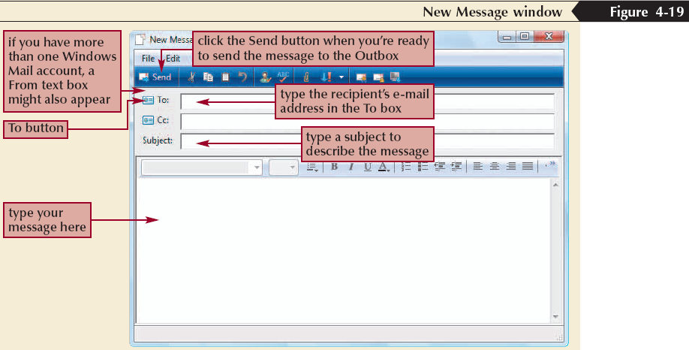
Creating and Sending an E-mail Message

Slide 46
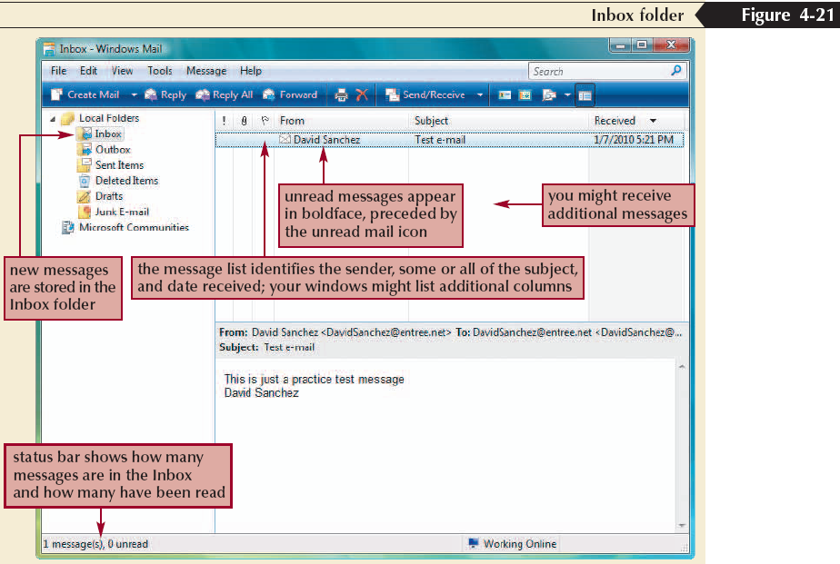
Receiving an E-mail Message

